Slide 1
MIS Midcorp introduction
July 2020

Slide 2
Agenda
01. Project background and objectives
02. Project organization, governance & design principles
03. High-level planning/roadmap

Slide 3
Management information system – reasons and opportunities
Project background and objectives
Details on following slides
Situation
Current challenges
Data as a strategic asset
3 business areas identified to benefits from data driven approach
Data currently not fully leveraged as competitive advantage for Allianz:
  Limited quality especially in contracts limiting data usage
  Low ease of data access through heterogeneity of data sources
  Lack of harmonization across OEs and low usage on local level
SE BoM request to build a Management Information System to support all 3 areas:
  H4: Develop MIS for core strategic topics (Claims, Push2Pull and MidCorp) by 2Q 2020
  H9 & H4: Include 5-year history of data in MIS and use steering methodology for MidCorp business by 3Q 2020
First focus on MIS Midcorp to support in steering business by 3Q 2020
Midcorp
Higher Technical excellence
Improved risk selection
Early indication and alignment on target portfolio performance and required actions
Claims
Claims efficiency (STP case)
Claims effectiveness
Claim fraud
ACM Claim identified MIS as key driver for transformation
Push to Pull
Strengthen & promote the AZ brand through customer-centric use cases
Increase lead generation
Enable cross-/up-selling opportunities

Slide 4
MC MIS SCOPE FROM A USAGE POINT OF VIEW…
Current (MVP version)
Mid Term Goal (GDP, end 20)
Long Term Goal (GDP, 21 ff)
User benefits
Each OE can use their own data for deep dives and visualize their Property portfolio in dashboards.
First group benchmarking views – indicative.
Data quality dashboards available.
Same benefits +
OE financial data are available in the dashboard (update each quarter)
Deep Dive dashboards and interface exists.
Dashboard handles versioned data
AI approaches developed on data scope such as LCE resource steering or micro-segment customer cluster analysis
Aggregated views across all OEs for all data.
Mngt. reporting for Group and individual OEs
Deep dive templates directly embedded.
Benchmarking against OE data is possible.
Dashboard handles versioned data and can report across all data assets.
Data is updated with sufficient high frequency across all Oes.
Scope of data & functionalities
Scope:
35 Data attributes
Including minimum 5 historical UW years.
Functionalities:
Snapshot in time at various reporting dates.
Handling multiple currencies with conversion before data import.
Access to different submissions at different reporting dates.
Scope:
similar to the MVP version
Functionalities:
Multi currency polices can be handled at import.
Multi section polices can be handled at import.
Claims / policy data history is built up with each data import.
Half yearly (manual) data updates
Scope:
Integrate all MC line of business Ops data
Integrate commercial, potentially retail data
Functionalities:
Different fx rates possible for aggregated view.
Quarterly or monthly data updates if automated at least for ‘core’ OEs.
ind. claims developments and claims triangles can be generated
Operational data
Financial data
Scope:
Currently not available
Scope:
Data available on the Solvency II LOB reporting database
Functionalities:
Financial reporting per OE and across OEs along the database granularity
Scope:
Data available on the Solvency II LOB reporting, potentially with higher granularity
Potential integration of additional data through TOM CC
Potentially financial data for extended lines
Functionalities:
Bridging of financial and operational data
Other data
Scope:
Currently not available
Scope:
Integration of all inspection data from LCE360 platform
Functionalities:
Based on the currently developed Use Case
Scope:
Integration of further data sources (ASPIRE, UW Workbench, Pricing,…)
Functionalities:
Meaningful historization and update frequency.
TBD.

Slide 5
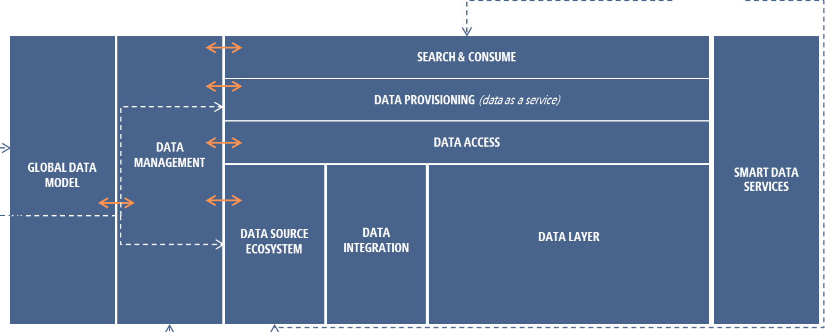
GDP as key enabler for MIS MidCorp
MIS MidCorp
Underwtiring Workbench / MCP
Radar Pricing
LCE 360
OE Core System
Solvency2 Database
OE Finance System
CAT DWH
Source Systems will be connected to GDP by integrating them with Data Management
With the recorded information, GDP will be connected to Source system and data will be ingested
Data ingested into GDP are stored first within raw layer, from there, data are processed according to the business definition into other data and provided to end user in the search & Consume layer
Data lineage is ensured via Data Management, so every data point provided to MIS MidCorp users can be tracked up to the source data elements
MIS MidCorp established in the search and consume layer for Dashboards
Additional integration with GIS and Radar is going to be facilitated via Smart Data Services.
More use cases for MIS MidCorp will be added when available

Slide 6
PROJECT ROLES AND RESPONSIBILITIES SPLIT BETWEEN BUSINESS AND OPS/IT
Project organization, governance & design principles
  Roles & Responsibilities
Overall Project Business Leader: AZ Re
Business requirements (content & reporting): Business led; AZRe coordination
Insurance risk related data: AZ Re with input from business experts
Architecture: H4, making sure it fits with existing developments of group assets
MIS solution (tools & solutions): H4 implementing business requirements for reporting and capabilities defined by business with AZRe as coordinator for business users (AZ Re as business product owner)
OE onboarding: Task force led by AZ RE / H4 to support across OE, including nominated OE participants

Slide 7
PROPOSED PROJECT SETUP FOR BUILDUP OF MIDCORP MIS
Project organization, governance & design principles
Proposition for Sounding Board:
Join the steering committee meeting as guests once a quarter
Recieve all steering committee presentations
May join steering committee meetings on request depending on the agenda topics
Sounding Board
Steering committee
D. Vogler
N. Clutterbuck
F. Nedey
R. D’Agostini
S. Ivankovic
T. Dietz
A. Ahmed
F. Wijchman
W. Hauner
H2 (tbd)
M. Loeffler
J. Marin
Project lead
S. Habereder (AZ Re)
A. Michelet (H4)
Bus. Requirements
Lead: S. Habereder (AZ Re)
Solution design
Lead: M. Boudet (AZ Re)
Architecture & MIS Solution
Lead: C. Sutherland (H4)
OEs Onboarding
Co-Lead: tbd (AZ Re & H4)
Close involvement of Lead OEs¹
Coordinating with Lead OEs, GAPC, Global P&C, Finance
Leads Requirement Oversight group
Business (Data content & reporting, dashboards)
Insurance risk related data
Framework, process & governance
Architecture
MIS tools & solutions
Taskforce per OE
(including 2x OE names, AZRe, H4)
Local data mapping
Data ingestion & quality improvement
Name: project sponsors
1. Suggestion: AZ Germany, AZ UK, AZ France, AZ Benelux, AZ Australia
11

Slide 8
Proposed Approach for MIS MidCorp technical transition (2/2)
Timeline to be fine-tuned based on detailed specifications
Today
Full switch on GDP
OEs involved
OEs involved
Q2/20
Q3/20
Q4/20
Q1/21
Q2/21
Q3/21
Q4/21
Q1/22
Data refresh for Deep-dive meetings
Tier 2 Oes
(First data collection)
Data collection
Data processing & visualization
Activities conducted on AZ Re local platform
Tier 1 Oes
(Data refresh)
Data collection
Data processing & visualization
Activities conducted on GDP
Deep-Dive meetings
(Jun to Sep*)
MVP Solution Upgrade
(new functionalities)
Tier 1 & Tier 2 OEs data
Spec.
Integration on GDP & MSTR
Additional functionalities and integration of further Lines of Business
Data Refresh (2x a year)
Data Refresh (2x a year)
Additional data
Financial data
Spec.
Quarterly Update from GAPC LoB Reporting
MIS data request integrated in TOM CC process
LCE360 data
Spec.
Integration on GDP & MSTR
TBD
OE Onboarding
3 Pilot OEs
Direct integration to the GDP
All remaining OEs
Direct integration to the GDP
Frozen Zone
* Exception from Australia to be conducted in October

Slide 9











Transition period required for automated data collection. Bi-annually manual process proposed during convergence
Q3 2020
Q4 2020
Q1 2021
Q2 2021
Q3 2021
Q4 2021
Scope of OEs for each data collection
Tier 2 OEs first data request
Tier 1 OEs data refresh
Manual Data refresh
Manual Data refresh
Manual data collection
Bi-annually data refresh process for a better steering of the MidCorp business
Scope of OE to decrease over time, as the OEs join the automated data collection process
BNL
Automated data collection
(OE Onboarding)
Start rollout for pilot OEs
Increase OE scope throughout 2021
Connection of OE local data source with the MIS Solution
France, Benelux and UK as pilot OEs to refine the approach
Business lead required to coordinate demand management and support interaction with OEs
BNL
BNL
BNL
BNL

Slide 10
BACK-UP

Slide 11
data management needs to improve together with the development of the MIS solution
Activities already ongoing and key to the project
Description of activities required for data management
Parties involved
Define
Definition of all Data attributes, KPIs and calculation formulas for MIS MidCorp
Definition of all values for reference data
Definition of Data Quality requirements for every attribute
Definition of dashboards, including design, aggregation / drill down capabilities / dimensions, and data refresh requirements
Solution Design Workstream for MIS MidCorp Project
&
Data fitness council* to ensure global alignment
Core activity of the Solution design WS:
Already 46 mandatory fields defined and documented to cover the MVP solution and data refresh, KPIs documentation ongoing
Financial documentation to start as soon as Sign-Off received from Business requirements
Activity to be conducted every time a new use case / new KPI is defined
Measure
Systematically measure the actual Data quality in OEs
Completeness: ability to store, fill rate
Quality: Uniqueness, timeliness, validity, accuracy, consistency
Accessibility: Functional, business
Solution Design & OE Onboarding Workstream for MIS MidCorp Project
&
OEs (business owners and Data Officers)
Key for further integration:
Analysis to be conducted for each Group data asset before integration into the solution
Mapping on local level to be made as first activity for integration of OEs
Identify gaps
Analyze the gap between the actual and the required data fitness
implement action plans in order to bridge those gaps activating all relevant levers
OEs (business owners and Data officers)
* Including representatives from Global P&C, Life & Health, ACM, AZ Re, Group Data Analytics, GSMD, H4

Slide 12
Notes
Scope
  Claim & Policy data
  3 Pilot Oes: Benelux, UK & France
  MVP: for the first MVP the goal is to have the existing Microstrategy boards in place
Timeline
  Focus on Benelux & UK
  Every three countries end of the year, Beginning of October the build task should be ready
  Architecture & MIS Solution and OE Onboarding together
Tasks
  For the ingestion we should look to standardized the patterns formally, right now it’s all a little to informal and I’d like us to document these including patterns needed from the Data Vault Harmonized model approach → Squad
  So we should have a defined and documented approach to ingestion from xml, json, flat file, RDMS, then integrating data fitness (include Kamil) and then the DV model (Jasmin). It should cover approaches for establishing the right pattern to ingest data where CDC is used, rdms can provide the incremental, rdms/flat file which is not able to provide the delta.(Colin)

Slide 13
Status
Status
  Azure file share in place for Midcorp, being rolled out to other subscriptions
    Claims and Policy BNL raw data imported, need to apply the solution to other OEs files (already have the files, should be able to do it today)
    Raised some questions regarding Midcorp's requirements in the document
    Had a workshop with the UI team and Mattia, a new version is going to be deployed on Monday which we can start testing
    Will start working on the CDC POC
  Introduction to Data Mart model with Rohan and created first draft

Slide 14
Status
Model:
  Harmonized model: presentation of first draft
  Consumption model: presentation of first draft today
  Next steps:
    Adjustment of the model
    Clarifying questions regarding requirement document with Myriam

Slide 15
Status
Model:
  Harmonized model: created new entities for contractual amounts
  Next steps:
    Alignment with Myriam girda_policy_id vs. Local_policy_id + expire_date + inception_date
    Rollout of harmonized model on PostgreDB
  Rafael
    Had some productive discussions around the HEM
    Implemented a method to generate the technical fields
    Copied and currently editing the HEM mode in KSQL ( the target streams)
    Need to finish that and apply transformation needed, also pending importing to raw the other files apart from claim and policy

